Slide 1
Three days training program on ‘Repair, maintenance and operation of Tractor’ at KVK, Buxar during 11–13th August, 2021
11–13th August 2021, Buxar (Bihar)
A farmer’s training programme on “Repair, maintenance and operation of Tractor” was organized at Krishi Vigyan Kendra, Buxar, Bihar during 11-13th August, 2021 under CRP on Farm Mechanization & Precision Farming project. The training provided information about different important parts of tractor and their functions. The training programme was inaugurated by Mr. Hari Govind, Incharge, KVK Buxar, Mr. Ramkewal and Dr. Deokaran, SMS, KVK Buxar. He welcomed the farmers and apprised them about the course schedule of the 3 days training programme. The training course was conceptualized and accomplished by Dr. Prem Kumar Sundaram, Mr. Ramkewal and Dr. Pawan Jeet under the suggestions and guidance of Dr. Bikash Sarkar principal investigator of the Project.
Twenty farmers participated in the training program. Mr. Harigovind emphasized on reducing cost of cultivation through proper operation of tractors in the field through minimization of consumption of diesel by saving time. He also underlined that the farm machinery has now become essential for timely crop production and management. Dr. Deokaran narrated about the importance of tractors as farm machinery during the crisis of manpower at the peak season of farming. Shri Ramesh Kumar and Shri Papu Yadav from Kailash tractor Mahindra, Buxar also gave practical training on the servicing of tractor. They were also appraised about precautions to be taken during its operation.
Valedictory session of three days training programme was conducted in the presence of Dr. Bikash Sarkar principal investigator of the Project, ICAR-RCER, Patna, Dr. Pawan Jeet, Scientist, ICAR-RCER, Patna, Mr. Hari Govind, Incharge, KVK Buxar, Mr. Ramkewal, Dr. Deokaran, Dr. Mandhata Singh, SMS, KVK Buxar and supporting staffs members of KVK, Buxar.
1
P.T.O

Slide 2
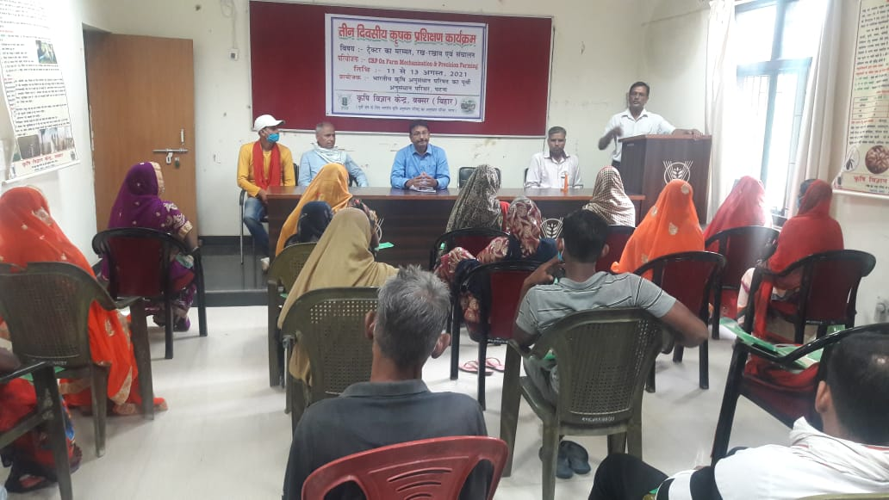
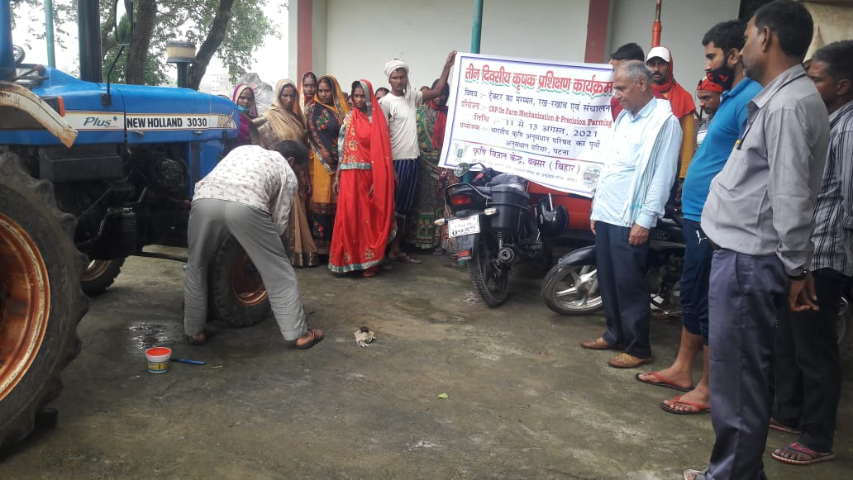
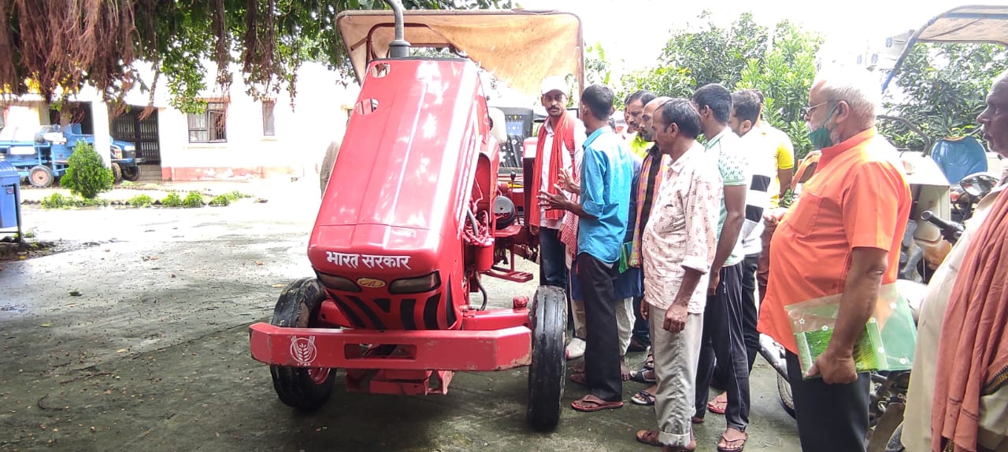
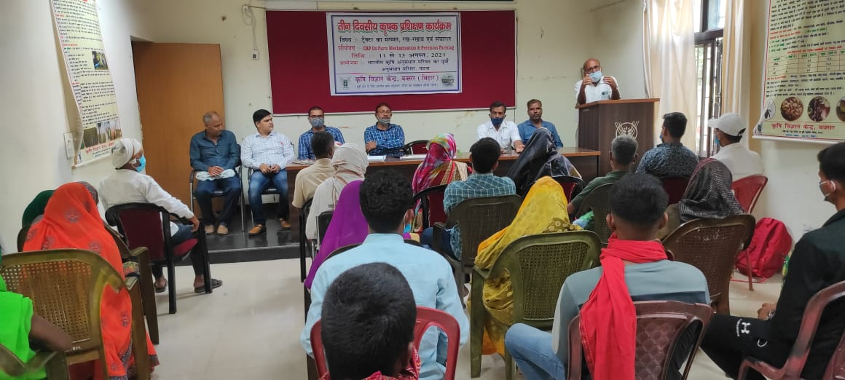
Glimpses of the three days training program
11-13th August 2021, Buxar (Bihar)
Training at KVK, Buxar
Exposure cum training and Valedictory session
2
Three days training program on ‘Repair, maintenance and operation of Tractor’ at KVK, Buxar during 11-13th August, 2021

